Slide 1

VALLURUPALLI NAGESWARA RAO VIGNANA JYOTHI INSTITUTE OF ENGINEERING AND TECHNOLOGY
Department of Computer Science and Engineering
Backpropagation

Slide 2
What is backpropagation
What is Backpropagation?
The Backpropagation algorithm looks for the minimum value of the error function in weight space using a technique called the delta rule or gradient descent. The weights that minimize the error function is then considered to be a solution to the learning problem.

Slide 3
Steps involved in Backpropagation:
Below are the steps involved in Backpropagation:
Step – 1: Forward Propagation
Step – 2: Backward Propagation
Step – 3: Putting all the values together and calculating the updated weight value

Slide 4
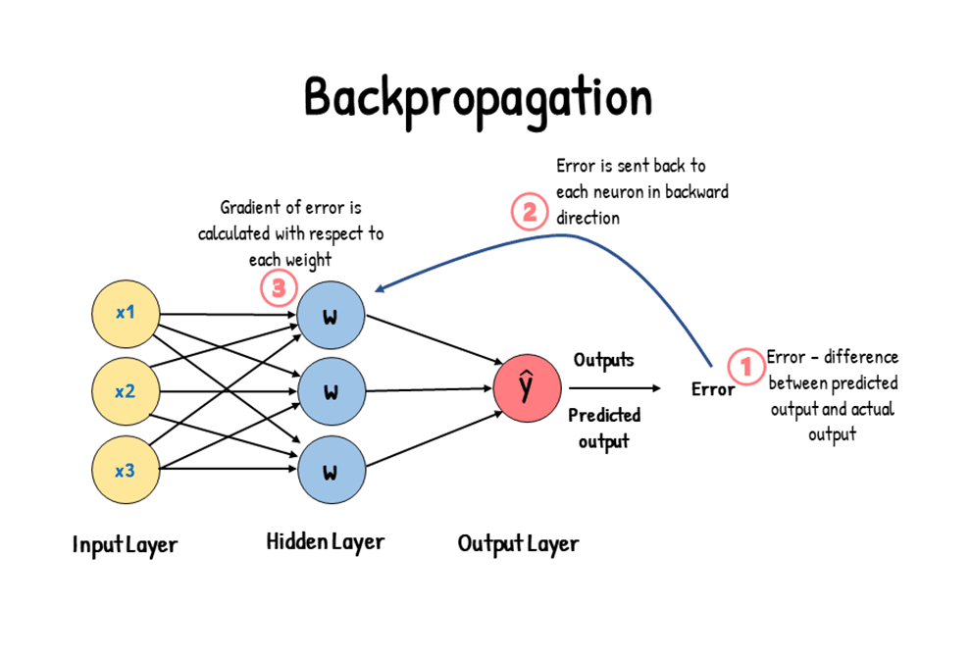

Slide 5
Backpropagation algorithm steps
Perform a forward pass to compute outputs and loss.
Compute the error signal at the output layer.
Propagate the error backward through the network using the chain rule.
Compute gradients for weights and biases.
Update weights and biases using gradient descent or similar optimization methods.
Repeat the process over multiple epochs with training data.

Slide 6
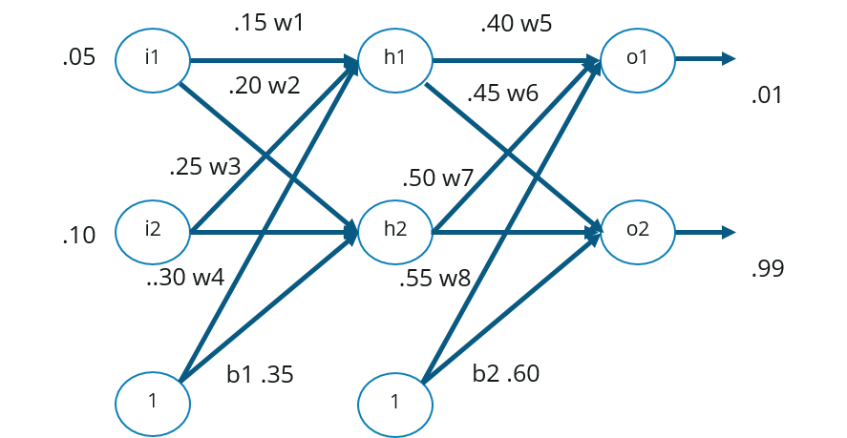
How Backpropagation Works?
i1-→h1=0.15
i2-→h1=0.20
1-→h1=0.35
i1-→h2=0.25
i2-→h2=0.30
1-→h2=0.35
h1-→o1=0.40
h2-→o1=0.45
1-→o1=0.60
h1-→o2=0.50
h2-→o2=0.55
1-→o2=0.60

Slide 7
The above network contains the following:
two inputs
two hidden neurons
two output neurons
two biases
Below are the steps involved in Backpropagation:
Step – 1: Forward Propagation
Step – 2: Backward Propagation
Step – 3: Putting all the values together and calculating the updated weight value

Slide 8
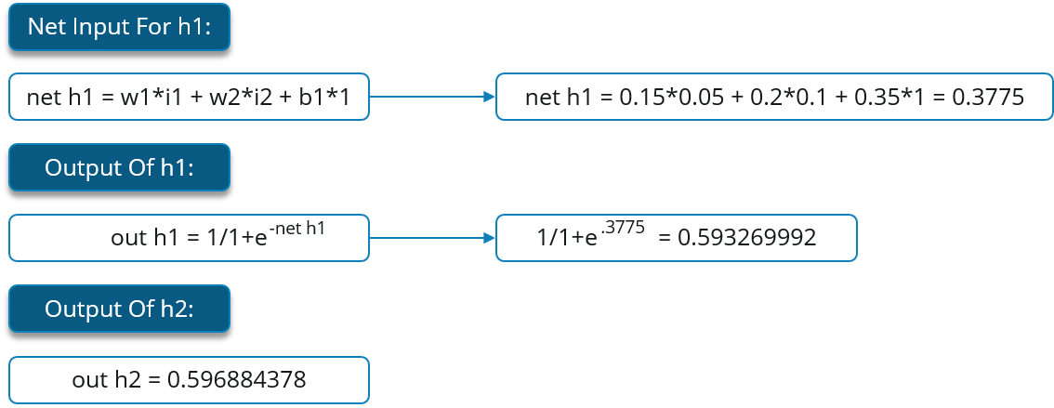
i1-→h1=0.15
i2-→h1=0.20
1-→h1=0.35
i1-→h2=0.25
i2-→h2=0.30
1-→h2=0.35
h1-→o1=0.40
h2-→o1=0.45
1-→o1=0.60
h1-→o2=0.50
h2-→o2=0.55
1-→o2=0.60
Step – 1: Forward Propagation
We will start by propagating forward.
Net h1
Out h1
Sigmoid(net h1)
Pre-activation
Sum of products of inputs and weights
Non linear activation function/ activation

Slide 9
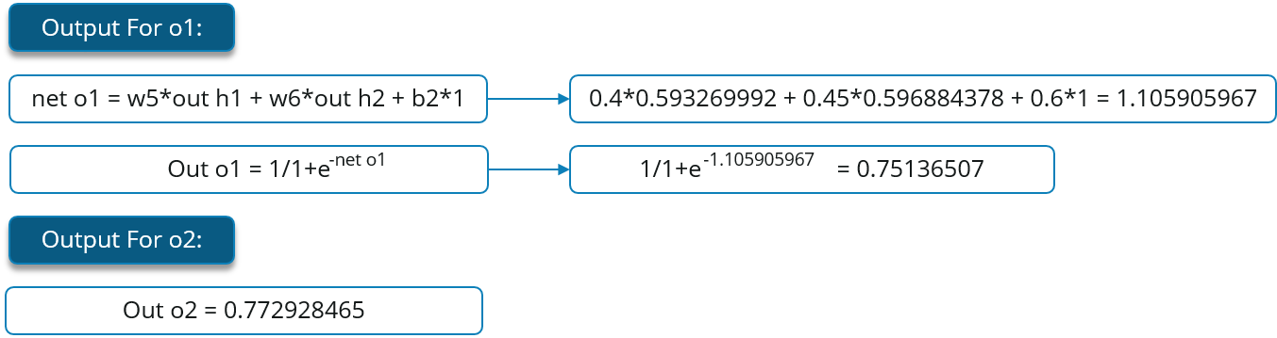
We will repeat this process for the output layer neurons, using the output from the hidden layer neurons as inputs.
i1-→h1=0.15
i2-→h1=0.20
1-→h1=0.35
i1-→h2=0.25
i2-→h2=0.30
1-→h2=0.35
h1-→o1=0.40
h2-→o1=0.45
1-→o1=0.60
h1-→o2=0.50
h2-→o2=0.55
1-→o2=0.60
Same process as above

Slide 10
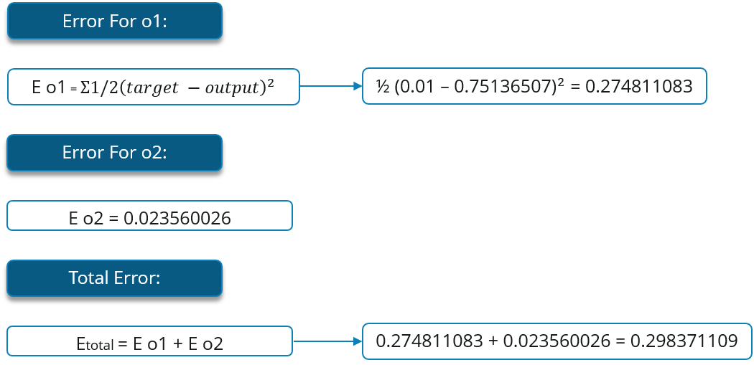
Now, let’s see what is the value of the error:
i1-→h1=0.15
i2-→h1=0.20
1-→h1=0.35
i1-→h2=0.25
i2-→h2=0.30
1-→h2=0.35
h1-→o1=0.40
h2-→o1=0.45
1-→o1=0.60
h1-→o2=0.50
h2-→o2=0.55
1-→o2=0.60

Slide 11
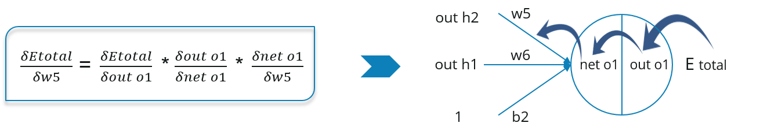
Step – 2: Backward Propagation
Now, we will propagate backwards. This way we will try to reduce the error by changing the values of weights and biases.
Consider W5, we will calculate the rate of change of error w.r.t change in weight W5.
Since we are propagating backwards, first thing we need to do is, calculate the change in total errors w.r.t the output O1 and O2.

Slide 12
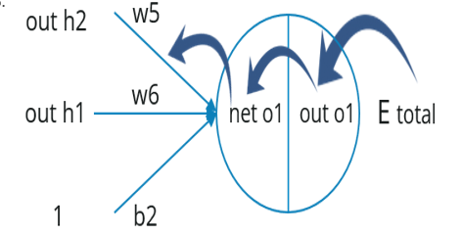
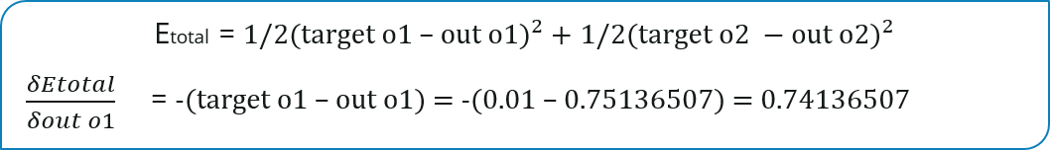
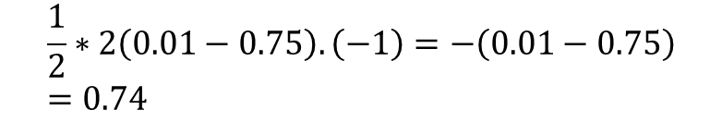
$$\frac{1}{2}∗2\left(0.01−0.75\right).\left(−1\right)=−\left(0.01−0.75\right)=0.74$$

Slide 13
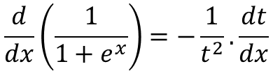
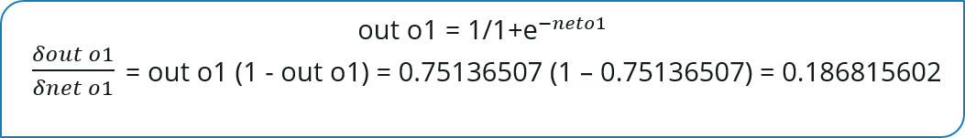

Now, we will propagate further backwards and calculate the change in output O1 w.r.t to its total net input.
$$\frac{d}{dx}\left(\frac{1}{1+e^{x}}\right)=−\frac{1}{t^{2}}.\frac{dt}{dx}$$
$$\frac{d}{dx}\left(e^{−x}\right)={−e}^{−x}$$
$−\frac{1}{{(1+e^{−neto1})}^{2}}$.$\frac{d}{−neto1}\left(1+e^{−neto1}\right)=\frac{ e^{−neto1}}{{(1+e^{−neto1})}^{2}}=\frac{1}{1+e^{−neto1}}$.$\left[1−\frac{1}{1+e^{−neto1}}\right]$ = $\frac{1}{1+e^{−neto1}}$[$\frac{(1+e^{−neto1})−1}{1+e^{−neto1}}]=out o1[1−out o1]$

Slide 14
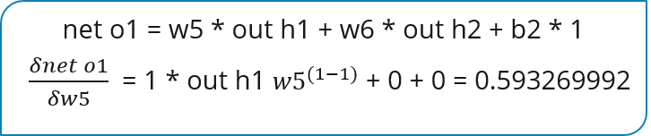
Let’s see now how much does the total net input of O1 changes w.r.t W5?

Slide 15
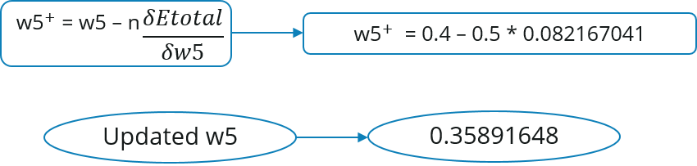
Step – 3: Putting all the values together and calculating the updated weight value: weight updation rule or delta rule
Now, let’s put all the values together:
Let’s calculate the updated value of W5:
Learning rate

Slide 16
The Delta rule searches for these weight vectors and uses them to generate the output for a given training example. Then by measuring the error, it would update the previously chosen weights to new values in a way that the output for the subsequent training examples would get closer to the ground truth.

Slide 17
The learning rate is a hyperparameter that controls how much to change the model in response to the estimated error each time the model weights are updated. Choosing the learning rate is challenging as a value too small may result in a long training process that could get stuck, whereas a value too large may result in learning a sub-optimal set of weights too fast or an unstable training process.
Similarly, we can calculate the other weight values as well.
After that we will again propagate forward and calculate the output. Again, we will calculate the error.
If the error is minimum we will stop right there, else we will again propagate backwards and update the weight values.
This process will keep on repeating until error becomes minimum.

